Slide 1
Single source of truth: documenting incident response
Casey Beaumont

Slide 2
AGENDA
Introduction
Roles and Responsibilities
Having a PLAN
Major Goals
Documentation Under Pressure
Deliverables
Summary
Notes:
We’re going to go over a lot of things in this presentation- starting with preplanning around roles and responsibilities and having an incident response plan in place so all this isn’t just knowledge in the head of someone on your IR team but formally documented.
Then, we will assume you’re in the midst of an incident and discuss what needs to be documented and how, and the best ways to keep those deliverables neat and helpful.
We’ll tackle both created documents for easing the investigation, incident artifacts themselves, and after action.

Slide 3

INTRODUCTION
Casey Beaumont
@silhouette_sec/@Silhouette@defcon.social
B.S.E. in Computer Systems Engineering from ASU
Incident Response Manager at Marsh McLennan, a global financial services firm
Forged in the fire of the defense industry
10+ years in Incident Response
Sucker for process and documentation
Notes:
Been coming to CactusCon off and on since it was hosted out of Dave and Busters

Slide 4
Roles, Responsibilities, and realities

Slide 5
Disclaimer time
There is no one way to do this
Do what is best for YOUR organization
You may not be at a sophisticated organization, and that’s OK
Notes:
Let me give the context that I work at a Fortune 500. We have staffing. We have documentation. We’re not perfect, but our level of sophistication is higher.
If this is NOT you, customize to your needs. Take baby steps.

Slide 6
Why do you need an Incident response lead? A scribe?
Depending on the size of your organization, it may be an unrealistic luxury to have dedicated staffing for this.
You could be any of these things:
Two people responsible for all of security as well as IT for a small company starting from scratch
Dedicated security team, but small and stretched thin
Part of a large, mature organization
However, you need to define WHO steps into these roles ahead of time, even if they will be multitasking, because otherwise NO ONE WILL and you may flounder
Notes:
The first time I gave a talk on Incident Response Plans, it was at a conference for rural broadband telecom, an industry I wasn’t intimately familiar with.
Before my talk, I participated in a tabletop exercise that revealed to me that most of the companies represented were across the board understaffed, wearing multiple hats, and not at the level of sophistication you may get used to in a larger company. When faced with a question like “how does your vulnerability management team handle new major threats in the news, like SolarWinds?” some of them said “we don’t”.
It made me realize that my talk was catered to a different audience, but the principles still applied and I made some changes.
The important thing is that you do what you can. Some level of preparation can make a world of difference regardless of tooling or staffing.

Slide 7
Roles and Responsibilities in IR bridging the gap between technical and business
“Cyber” Incident Response Team
IR Lead and Information Security Leadership
General Incident Response Team
Separate phone bridge working technical investigation
Keep management and business stakeholders off
IR Lead translates the technical updates and investigation progress into digestible content for the business
IR Lead and/or a separate scribe role are the single point of truth
Leadership can carry updates to senior management
Business-level handling of legal, privacy, continuity, client relationships, etc.
Briefing of the C-level, with the CISO providing representation for security
Notes:
Why is this important? What do these roles give us?
Let’s talk bigger picture here, particularly at larger companies where there may be separation between “major incident management” who also handles non-security issues like outages, and the “Cyber” security side of the house.
The Information Security IR team is going to be doing the technical investigation of an incident, but the business will have a separate team working the legal, privacy, continuity, “business” side of the house. In order for them to make efficient and educated decisions, the IR lead and scribe are instrumental in translating what is known into digestible content that can be acted upon.

Slide 8
Be prepared with an incident response plan

Slide 9
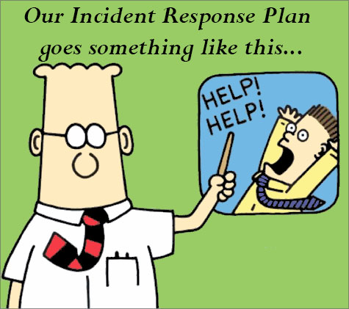
Not a good incident response plan
Notes:
If your incident response plan is “update your resume”, you’re doing it wrong.
Don’t rely on winging it! We all have to start from somewhere, but incidents can be emotional things and having a plan provides a guide rail to hold on to when things get tough.
“Can’t our third party IR firm do this for us?” Well yes, but wouldn’t you like to be able to focus them where YOU want and be using them to both confirm your own work and instantly increase your 24/7 staffing?

Slide 10




Incident Response Plan your place to detail your approach to Incident response so your org is prepared- in advance
Activities Required
Approach to Incident Response
Roles and Responsibilities
Contacts, Communication, and Metrics
Notes:
An Incident Response Plan, which can be extremely broad for any major incident an organization might face or specific to cyber security related incidents, is a centralized and shareable document or set of documents that can be utilized to set ground rules for:
What big picture activities are required, and what you hold yourself to as a company
What the step by step flow of processing an incident might look like to you
Who is involved in incident response and who are decision makers
Contact information to engage teams, communication requirements, and deliverables

Slide 11
General Incident Response Plans vs cyber incident response plans
Early triage to determine the type, severity, and impact of an incident helps dictate what teams are involved!
This talk mentions Incident Response Plans when it comes to Cyber Incidents specifically
A general IRP may cover more generic incidents your business might face, dictate at a higher level the organization’s overall response, as well as define how major incidents never involving IT security are handled
These IRPs are linked, developed together, and major incident response often involves both
Where the Cyber Incident Response plan often intersects with the General one is relating to Data incidents:
IT Security Incident
Data Incident
A company Information System was potentially compromised with no indication that Data was compromised (e.g., malware on a workstation)
Company Data, in whatever format, was potentially compromised (e.g., employee inadvertently mis-mailing company data)
Hybrid
Notes:
Your org may also want to implement a “significant incident” plan, which would be used where the incident has the potential to cause large-scale disruption to operations, revenue, or reputation. This involves the C-level immediately, the chair of the board of directors, and chair of the audit committee.
When an incident is serious enough to engage the teams on the general incident response side, they focus on items such as managing business outages, engaging cyber insurance, outside counsel, contacting law enforcement, public relations, regulatory notifications, litigation risk, notice to impacted individuals, etc.
** talk about who has control in a hybrid incident. What starts in one can quickly morph into the other. This is really the business on the right

Slide 12
Pieces of a progressive IRP
Policy
Big picture company policy on Incident Response – use a guideline, lay out your ground rules, and define roles and responsibilities
Process
Flow of events and all steps taken in a typical response in more detail
Playbooks
For IR and shareable to related teams to security – much more detailed, and how you approach certain situations
Procedures
The nitty gritty on how to perform specific tasks, which supplement playbooks
Notes:
Depending on your size and what you already have, you could have an incident response plan that all fits on one document.
What I’m talking about here is a way to break it into pieces so that parts are sharable and can evolve over time.
An incident response policy addresses purpose, scope, roles, responsibilities, management commitment, coordination among organizational entities, and compliance;
Don’t reinvent the wheel- pick a guideline such as NIST, and base your policy around it.
Your process will facilitate the implementation of the incident response policy and associated incident response controls. Steps on processing events into incidents, not a magical process for IR
National Institute for Standards and Technology (NIST) Special Publication (SP) 800-53 Revision 4, “Security and Privacy Controls for Federal Information Systems and Organizations” and the NIST SP 800-61 Revision 2 “Computer Security Incident Handling Guide,”

Slide 13
Where is this getting stored?
Ticketing
Main ticketing system
General tracking
Restricted Access
Point to further locked down repository
Privileged and Confidential
Further Encryption
Major IR might be Read-In Only
Stored Docs with Additional Protection
May be exposed to other colleagues
Define a retention period
Plan for legal holds
Standardize naming convention for records
Notes:
Before something happens, you need to know how you’ll be storing the information. What is your system of record? Who can look up information there?
Ideally, you’d have a ticketing system that has privacy for security related events- you can’t exactly put sensitive data in something that analysts can search for easily.
Store the sensitive bits somewhere you can control, but a tracking ticket is still necessary for metrics. Inside, point to the actual repository.
If something is significant or had a “need-to-know” level of access, further encryption may be required to protect the data.

Slide 14
goals
Notes:
So I could deep dive very heavily into IRPs and the components of each, so if that interests you reach out to me after and lets talk as I’ve got a whole presentation on that. However, for this, we’re focused on what we want to accomplish specifically as an IR lead and/or Scribe in documenting a major cyber incident. So what are our goals?

Slide 15
First and foremost: get through the incident lifecycle
Prepare
Detect
Analyze
Contain
Eradicate
Recover
Post-Incident Activity
Prepare – training, required access and resources
Detect – detect anomalous behavior
Analyze – what do the artifacts tell us
Contain – considerations between business and safety
Eradicate – reimage vs eliminating artifacts
Recover – restore the business
Post-Incident – after-actions report
Important to consider: where does incident response leave your responsibility? Don’t tread on other groups
In the technical part of investigation, you’re going to hit some of these multiple times!
Notes:
Most importantly is that the investigation lifecycle is most important. Your job is to help the teams quickly and efficiently move through analysis, containment, and eradication without having to manage on their own the documentation side of things.
Preparing is what we’ve already discussed. It also encompasses your vulnerability management and all the work you do to strengthen your org.
Detecting may be your SOC, may be a third party provider, may be a user reported issue.
Define a handoff between your SOC and IR for what truly is a concerning incident, and work together in the investigation
Recovery is where security may start to hand off responsibility- other teams can take on rebuilding, application work, and architectural changes

Slide 16
Get the right parties involved
CISO
Major Incident Management
Legal and Privacy
Business Owners / Client Facing
Messaging
Cyber Operations
Active Directory
Networking
Compliance
Notes:
A big part of incident response as a leader is getting the right parties notified immediately. Your process may help define who notifies who (such as the CISO briefing the C-level as required) but it’s important to be timely both for regulatory reasons (for Legal) and so that a business CISO isn’t the last one to hear about an incident affecting their organization. Notifying the right people can help you get the resources you need, fast, as well as keep people happy and informed.
You may have resources that can help you find the people you need, like Major Incident Management, or you may need to do this pre-work yourself and make sure you can find the contact you need when you need them.

Slide 17
What do we want to accomplish with our records of the incident?
BE ABLE TO TELL THE STORY AND ANSWER QUESTIONS LATER
Variety of overview statements for different audiences
Timeline to speak to what happened, when
DETAILED, SEARCHABLE ARTIFACT AND HOST LIST
Ability to cross-reference future incidents with systems or Indicators of Compromise (IOC’s) noted in this incident
Ability to confirm actions taken on affected hosts
LEGAL RETENTION CONSIDERATIONS
This could come back as a court case, particularly if data was lost or media attention
Accurate, objective documentation is essential for your Legal Team

Slide 18
Legal considerations
Timestamps and context for reporting deadlines under law or contract – PCI, HIPAA, GLBA, FISMA
Asset location or exposed data involved may have region-specific reporting requirements
Preservation of evidence and retention period
Client/customer notifications
For involved parties managing the incident:
Legal holds
Stop-trade orders
The SECOND this becomes a data incident too, legal considerations become extremely important
Notes:
This is especially important the SECOND this becomes a data incident. Depending on your industry, your global presence, and your customers, you may have different regulations you need to be mindful of.
PCI – Payment Card Industry
HIPAA – Health Insurance Portability and Accountability Act
GLBA – Gramm-Leach-Bliley Act or Financial Services Modernization Act of 1999
FISMA – Federal Information Security Management Act – federal government

Slide 19
It’s 2 AM and the phone rings
Notes:
OK, so now it’s time to talk about how this plays out when you get paged for something funky happening off-hours. It has to be off hours, or Friday at 4 PM, because of course it does.

Slide 20

How does this play out?
On a long-enough timeline, we all get popped
Worst case scenario:
Someone’s already got your data and has told you so
You don’t have a playbook for this yet
You’re starting with limited information – you don’t know root cause, or what systems / accounts are compromised
It’s time to engage that call tree and get all hands on deck
Improvise – Adapt - Overcome
Notes:
Typically this clip of the matrix just shows Neo dodging bullets, but I had to expand it a bit to make sure it includes him getting clipped. After all, you may get lucky sometimes, or be rather prepared and skip a lot of potential issues, but inevitably something will happen to you.
Does your IRP give you the bare bones you need to get the right people on the phone and able to investigate this properly?
With the right preparation and experienced team, your goal is to feel so on top of it that if you’re engaging a third-party IR firm that you’re able to be ahead of providing them the data they need, investigating along with them, and having them as a third party confirming your notes. They don’t need to be performing the IR Lead functionality for you and walking you through it.
Regardless of planning, You still need GOOD people and GOOD logging to allow them to make the connections and tell the whole story.
With a proper IRP though, the different teams can work in lockstep and make informed decisions quickly to minimize pain.
**even in a best case scenario you may need to improvise from your playbook – improvise, adapt, overcome

Slide 21
Incident Response Lead
Incident Stand-Up
Create dedicated incident resources: conferencing, file repositories, out-of-band comms, place for incident documentation, ticketing as applicable.
Initial Notifications
Notify security teams needed for investigation and leadership. Engage teams to pull in the right resources around affected systems or applications.
Delegation of Tasks and Decision Making
IR Lead delegates investigation tasks, tracking with timestamps all developments. Ensure that the IR Lead is equipped with the authority to make calls on necessary actions.
Reporting Status
Translate developments into digestible status for management
Notes:
Mention an initial “what we know” notification for leadership
Make sure you define who has the authority to make a call on something controversial, and who takes the political fallout for that decision. For example, containing a production system. Deactivating the accounts of a VIP. Define in advance whether your organization is a “burn it with fire” org or wait, watch, and listen.

Slide 22
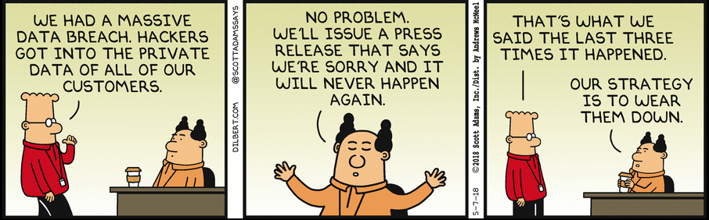
Rules of communication
YOUR PROBLEM
NOT YOUR PROBLEM
Team Communication
Out-of-Band Communication
Public Statements
Client Communication
Internal Notifications
Everything could be in court one day
No “we are so screwed!” discussion
Discuss with Legal
No disappearing messages!
Notes:
Discuss in advance how you want to handle communication. What tool do you use? What is acceptable or not acceptable? Do you need to access control the groups, or archive the chat? Remind folks that everything in this chat could be in court one day, so maintain some level of professionalism.
For Out Of Band, make sure Legal is ok with your use of emergency comms. What if your network is down and you CAN’T use your typical comms, or they are untrustworthy? Make sure you have rules- NO disappearing messages on Signal, for instance.
The IR team is NOT responsible for public or even internal widespread communications- you have a Communications department for a reason. No one talks to media, clients, or widespread internally without going through the proper channels.

Slide 23
staffing
Get an understanding of your team size and how you’d staff a major, extended incident.
What are your expectations? 24/7 work? Engagement of a 3rd party and handing if off?
Don’t be limited to dedicated IR- you may have other team members with skills and passion who want to be involved, even to just learn.
Consider:
Planned shifts and downtime
Team time zones and how that may affect shifts
Paired (at least) bodies on deck at any time
Who is managing BAU tasks?
Can you reward or make easier these long hours?
Notes:
Figure out with your teams what amount of hours is reasonable to ask. Incident Responders are hungry to dive in, and often the problem is forcing people to go sleep, so set rules in place.
One way of doing it is everyone is on during the business day, into the evening, but then you break late evening and overnight into smaller 2-man shifts so everyone gets a chance to sleep.
Consider as a lead, do you have any type of slush fund to help keep your team going? Can you doordash for them? Can you reward at the end with additional time off, a bonus, or any other perk? When you’re through the incident, consider a challenge coin to signify you got through this together.

Slide 24
Creating the single source of truth
Notes:
Now we’ve reached deliverables- what are we generating throughout this incident?

Slide 25




Scribe gets to work
Overview Document
Tracking Spreadsheet
Timeline
File Storage
Statuses, loose notes, copies of correspondence, list of who’s involved, proposed recommendations for AAR
Systems, accounts, host IOCs, network IOCs, requests and task tracking, evidence tracking, and forensic keywords
Track timestamps in UTC
Log files should all include hostname, file description, and timestamp for storage

Slide 26
Overview Document
Prepared Statements
Background – what kicked this off and what did we initially know?
Detailed Running Notes
Include ticket numbers related
Outstanding Actions, References, AAR Recommendations
Who is working what, any actions required, and timestamps reported complete
URLs for relevant references/articles
At the end- create a “Compromise Overview” – tell the story
Copies of every status email
May have versions of overviews for different audiences – technical vs non-technical
Break into dated subsections
Timestamped (UTC) developments, copies of third-party correspondence, detailed notes from calls
Appendixes
Output from IR firms
Read-in individuals
Copies of attacker correspondence
Contact information
Longer-term recommendations to strengthen environment
Notes:
This can be a HUGE document if your incident is major
I also speak in terms of doing this all in a Word document. You can do this however your environment or tooling enables you to. Some ticketing systems may have ways of doing this and tracking all in one ticket. In our case, we didn’t have privacy into what went into tickets so we created a master tracking ticket that pointed to a protected SharePoint.

Slide 27
Tracking spreadsheet
Timeline Data
Systems
Accounts
Host IOCs
Network IOCs
Request and Task Tracker
Evidence Tracker
Forensic Keywords
Notes:
Use what you like- previously I’ve rolled my own but Crowdstrike has an excellent one you can customize to your situations. I’ve got a copy on my Github.
It’s helpful to capture details you might not consider in the moment

Slide 28
Tracking spreadsheet – what to track
Systems
Name / IP
Domain
Accounts
Account name / SID
Domain
IOCs
IOC type
OS
Role
Why was it identified
Significant Findings
Earliest and latest evidence in UTC
Role
Significant Findings
Status (active/not)
Earliest and latest evidence in UTC
Indicator
Full path if applicable
Hashes
Type/Purpose
Size
ATT&CK Alignment
Task Tracking
Work Stream
Request
Log of updates
Assigned to
Status
Date Updated
Date Completed
Status (contained / reimaged / left alone)
Notes:
You may want to share IOCs later with others

Slide 29
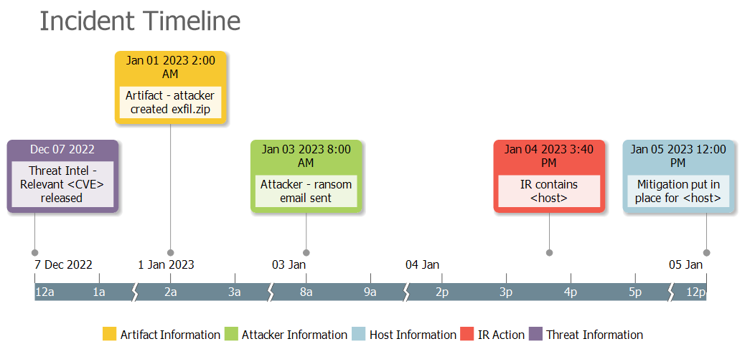
Timeline creation
Notes:
Provides nice visual view
Use whatever tool you like, this is Timeline Maker Pro
Use of a dedicated tool can give flexibility on only showing certain types of events, ways to view it, etc.

Slide 30
File Storage
BE ORGANIZED – THIS STUFF PILES UP
System
Event Logs
Acquisitions
Network
Firewall logs
SIEM pulls
Email
Email records
Browser Logs
Account activity
IIS Logs
UEBA
Stored files should note:
Date obtained YYYYMMDD
Data type
Host or source
Time-range if applicable
Can be organized by file structure, but in the end just be able to identify what you’re looking for later!
EXAMPLES:
20220530_email_caseybeaumont_30days.xlsx
20220602_HOST_Application.evtx
Notes:
User and Entity Behavior Analytics (UEBA)

Slide 31
After Action

Slide 32

After Action
We did it and kept our jobs too!
Hold on- don’t repress this yet!
Document:
Background
Actions Taken
Response Review
What was Successful?
What Can Be Improved?
Any Recommendations to the Business?
Notes:
**As you document, be noting items for AAR
IR events are stressful, but you have to be prepared for the next IR immediately following. Staged closing of the current incident so you can refresh but still be ready for another IR

Slide 33

Document those changes
Get Sign-Off From Stakeholders
Process Improvements
Emergency vs. Proactive Changes
If you don’t have written agreement to fix something, it’s NOT GOING TO HAPPEN
Agree on timelines
May want to loop in Legal/Management
Determine who has accountability
How did your IRP let you down?
What information were you missing?
What stumbling blocks did you encounter?
Close the exposures used by an attacker in real-time
Identify weaknesses that were exploited that may need planning to close
Track those changes that may incur time and cost
Notes:
In your after action you might come up with recommendations. However, you can’t just say “do this” but hand it off to only your management who fully may drop the ball on having it happen. You need to get SIGN OFF from the person performing the action.
In our org, this may need agreement from management, the owner, and possibly legal if needed. Define in your org who is responsible for checking in and making sure this gets completed.
Every major IR is a perfect opportunity to detect failures in your IRP, playbooks, and procedures and IMPROVE. Define what may need adding! Refine what might be out of date!
In major IR, you’re going to be closing holes in real time, and ensure you document those. But it may prompt wider spread changes (and checking where else you may have similar vulns) and those should be owned by the business.
** Point back to recovery- take corrective actions, tough when time+money are involved

Slide 34

Archive and move on
Having an IRP in place and defined leadership and documentation roles should have gotten you some wins, and kept more people happy about your response
Faster time to inform relevant parties
Faster and more consistent analysis and response
Happier teams with more cross-communication
Decision making responsibilities spelled out in advance
However, move on- the next one could be just around the corner
You’ll be happy you documented as thoroughly as you did when Legal comes asking for some specific detail nine months down the line!
Notes:
Unfortunately, IR is an ever-evolving beast, and you’ve probably had day to day incidents alongside this major one. When you can, wrap it up neatly and move on!
**you might have another big one, or an overlapping big one

Slide 35
THANK YOU and may the odds be ever In your favor
Casey Beaumont
@silhouette_sec
@Silhouette@defcon.social
Casey.L.Beaumont@mmc.com
https://github.com/silhouettesec/IncidentResponsePlans
Notes:
I know this was a lot of content. I have a github here that I have stripped down copies of example policy, process, and playbook, as well as a copy of that CrowdStrike incident tracking spreadsheet if you want to skip Googling it yourself. I’ll also add these slides for anyone interested. Additionally, if you find that your organization does this differently, or better, than I do, please find me and I’d love to chat and learn from each other. Now that we’ve covered a bunch of different things though, I’d like to open it up for questions!

